Slide 1
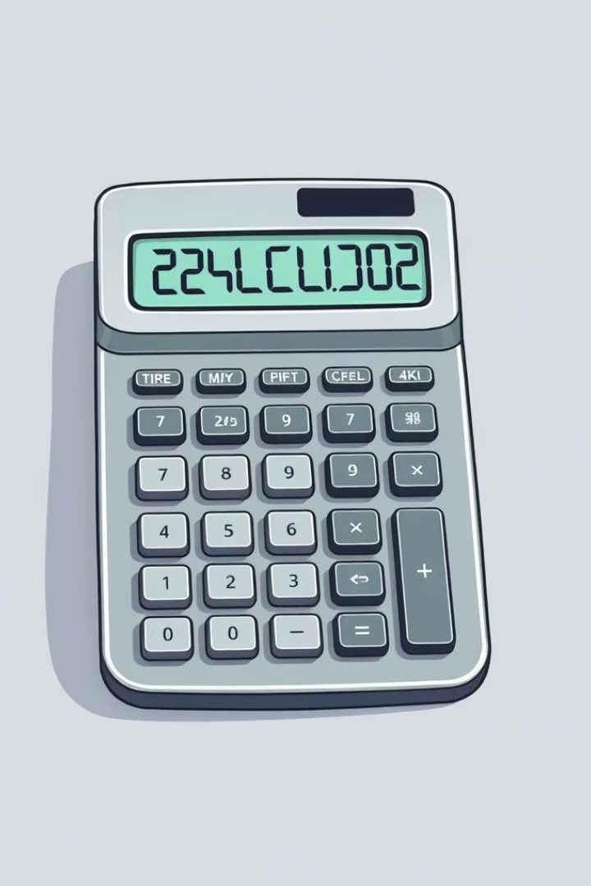
Calculator using HTML, CSS, and JavaScript
This project is a simple calculator app that utilizes basic HTML for structure, CSS for styling, and JavaScript to handle user interaction and calculations.
Made By : Gungun Jain
Roll No. : 2200290120071
Branch : CS
Sec : 5B

Slide 2
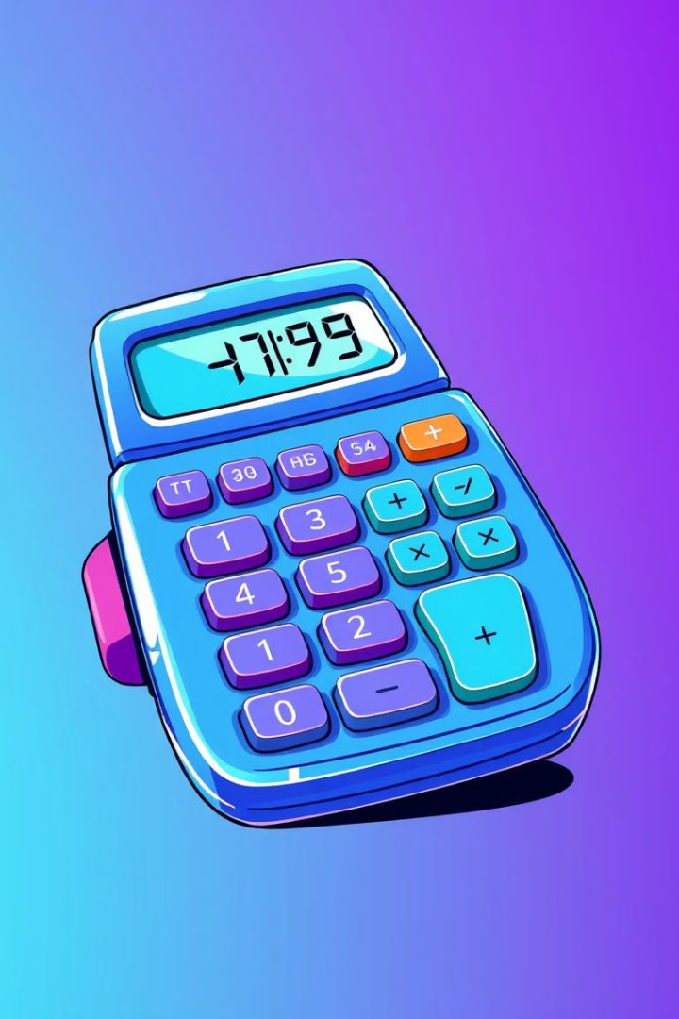
Introduction to the Calculator App
1
Functionality
2
Ease of Use
The calculator app provides a user interface for performing basic mathematical operations.
It's designed for intuitive use, with clear buttons and a straightforward layout.
3
Accessibility
The calculator is built with accessibility in mind, allowing users to easily navigate and interact with the app.

Slide 3

Key Features and Capabilities
Basic Operations
Advanced Operations
Error Handling
Addition
Percentage Calculation
The calculator handles invalid inputs and potential errors gracefully.
Subtraction
Square Root
Multiplication
Clear and Delete Functions
Division

Slide 4

Supported Operations and Calculations
Operation
Description
+
Addition
-
Subtraction
*
Multiplication
/
Division
%
Percentage Calculation
√
Square Root

Slide 5



Design Considerations and UI Elements
User-Friendly Layout
Visual Clarity
The calculator interface is organized for easy navigation and interaction.
Clear button labels, a well-defined display, and a clean visual aesthetic enhance usability.
Responsive Design
The calculator adapts to different screen sizes, ensuring a consistent experience across devices.

Slide 6
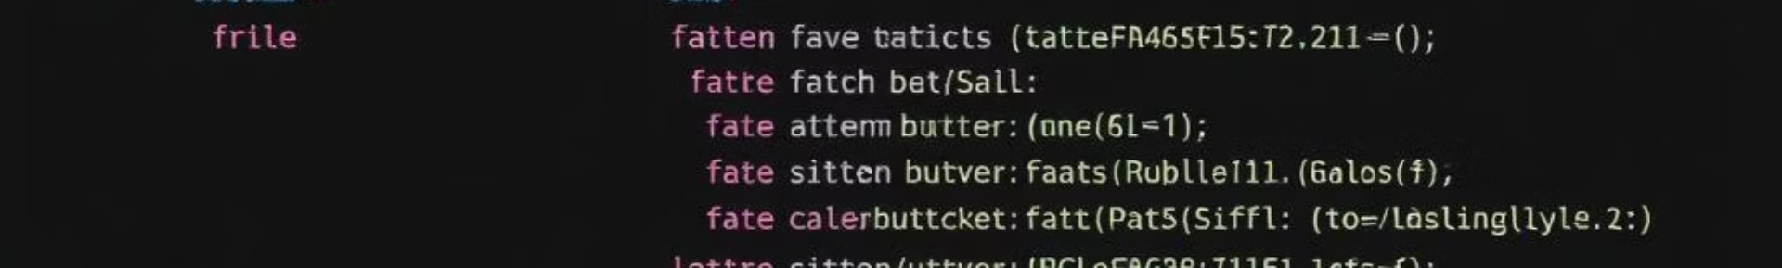




Code Structure and Implementation
HTML Structure
The HTML defines the layout, buttons, and display of the calculator.
CSS Styling
CSS provides the visual appearance of the calculator, including colors, fonts, and button styles.
JavaScript Logic
JavaScript handles user inputs, performs calculations, and updates the display.

Slide 7
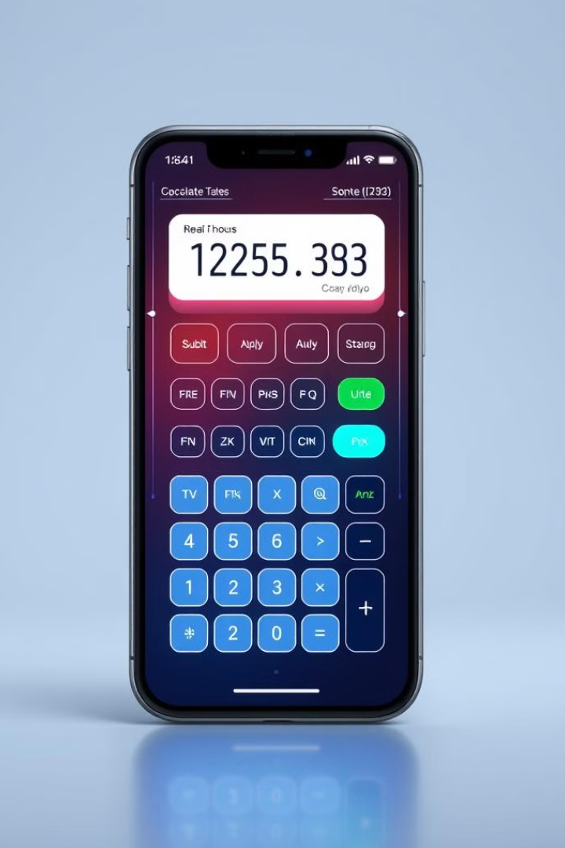


Conclusion and Future Enhancements
Functionality
Future Enhancements
The calculator app provides basic mathematical functionality and has the potential for expansion.
Future enhancements include additional operations, scientific functions, and memory features.

Slide 8

Thank You!
I appreciate your time and interest in my calculator app presentation.

